Slide 1

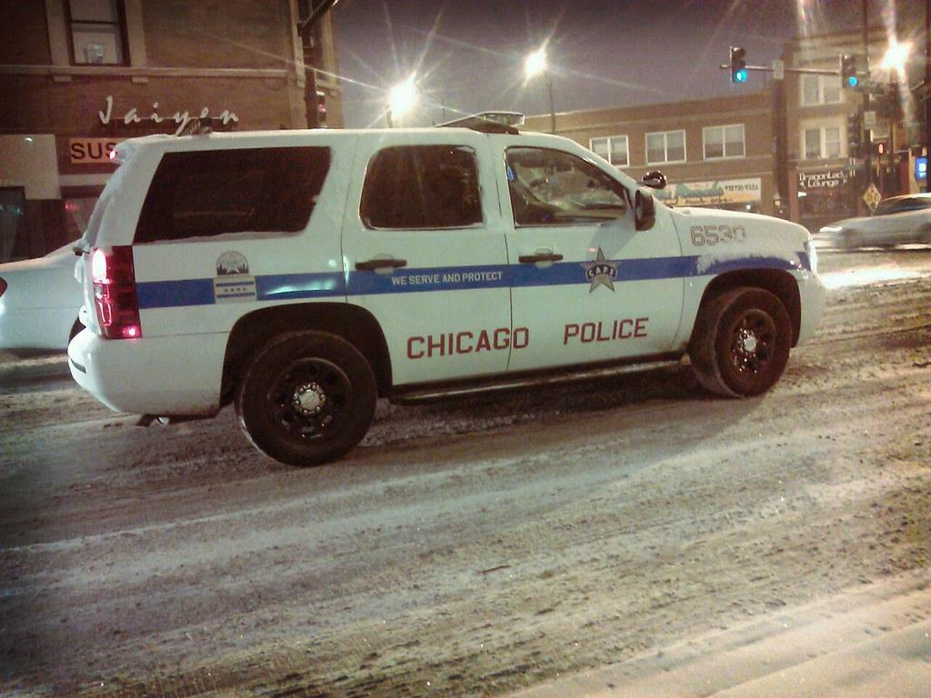
CHICAGO CRIME
ANALYSIS
PREPARED BY, KAJAL

Slide 2

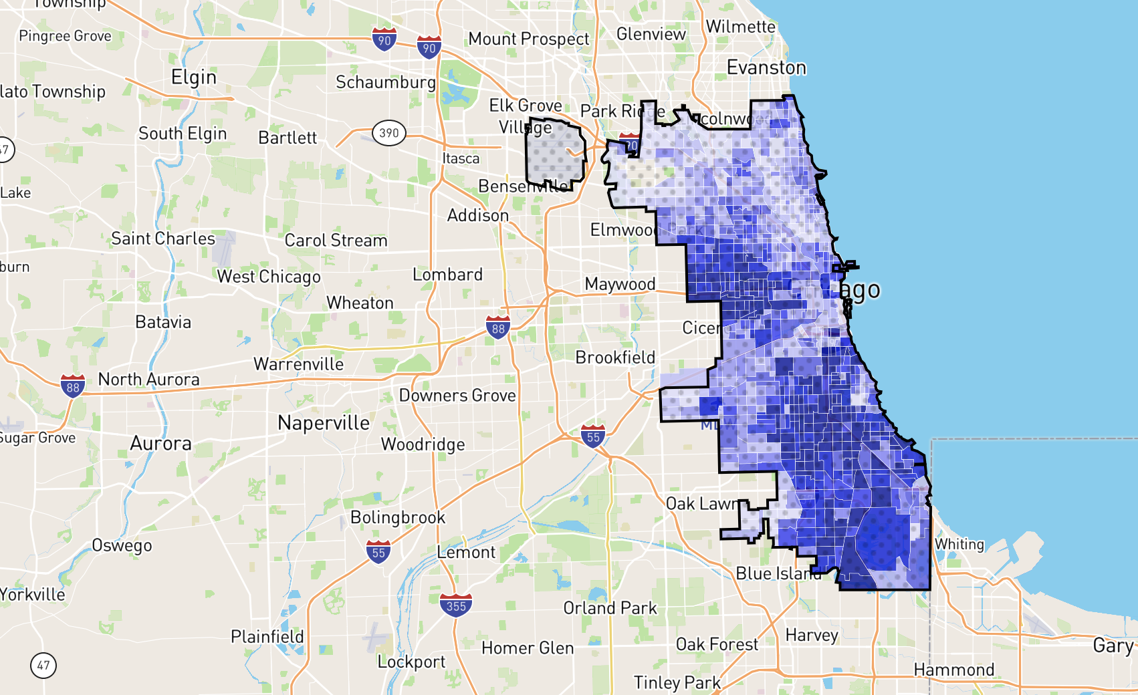
INTRODUCTION
Few year ago in CHICAGO, the alarming rate of criminal activity prompted the government to enact a proactive measure, deploying elite police officers in a targeted operation. Now, with twelve months elapsed since this initiative commenced, the government aims to assess the decline in criminal incidents and the benefits yielded from this newly implemented strategy.

Slide 3
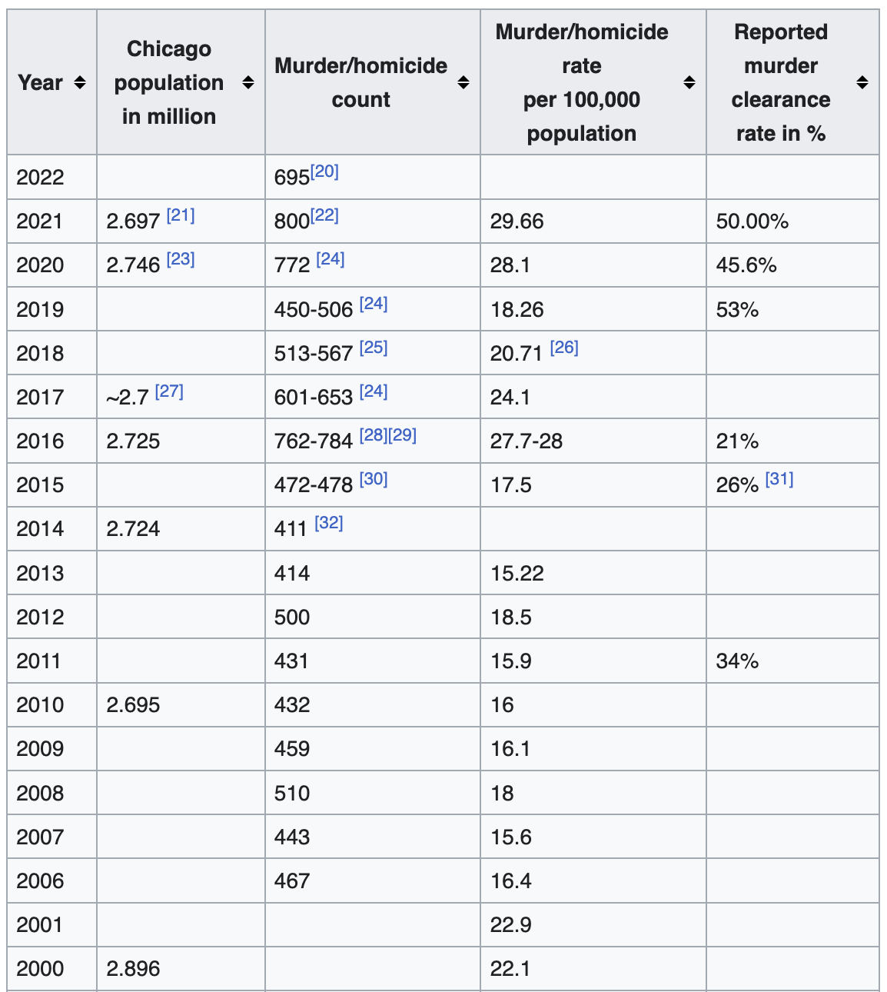
CHICAGO
Crime Overview
Crime in Chicago has been tracked by the Chicago Police Department's Bureau of Records since the beginning of the 20th century. The city's overall crime rate, especially the violent crime rate, is higher than the US average. Gangs in Chicago have a role in the city's crime rate. The number of homicides in Chicago hit a 25-year high in 2021.

Slide 4

Data Overview
Dataset : Incident records with key attributes like ID, Date, Type, Location, Arrest etc.
Metrices : Incident count, Arrest rate, Domestic incident rate, Location description and crime categories.
Exploration : Insights into crimes type, locations and temporal trends.
Quality : Removing missing values, validating geographical coordinates.

Slide 5

METHODOLOGY
Data Cleansing: Leveraged Power BI's Query Editor functionality to meticulously clean the data, ensuring precision and uniformity throughout.
Column Generation: Utilized DAX formulas proficiently to introduce supplementary columns, enriching the dataset for comprehensive analysis.
Sophisticated DAX Calculations: Crafted advanced DAX measures to extract profound insights and meet complex analytical demands effectively.
Visual Representation: Employed Power BI's diverse visualization capabilities to craft compelling visuals, facilitating easier comprehension and in-depth data analysis.

Slide 6
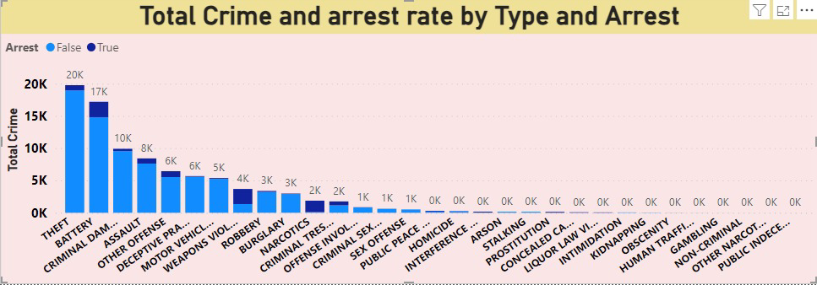
Analysis of Objective
Data: Cleaned null values.
Created new columns with DAX.
Analysis :
Top crime : Theft.
Arrest rate : 12.42%.
Highest incidents : District 6.
Many categorical columns.
Nulls : Removed from Ward, X & Y coordinates.
Domestic Crimes : 20.02% of total.

Slide 7
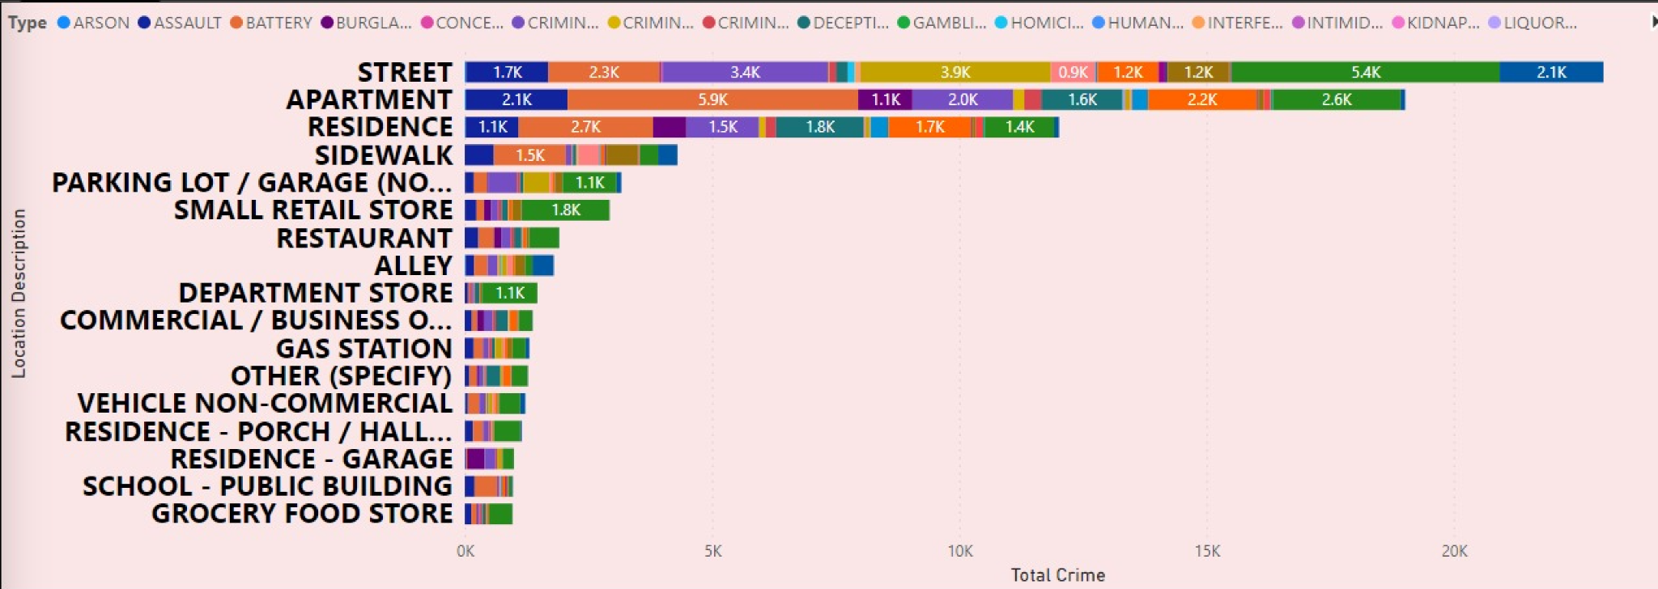
Analysis of Objective
Location: Streets report highest crimes.
Avg. Resolution Time: 9.03 days.
Patrol: Beat 511 has low crime.
Columns: DAX & Power Query for creation.
Calculate: Used for theft count in District 8.
Longitude/Latitude: Split using 'Add Column with Example'.
M Language: Employed for transformations.

Slide 8
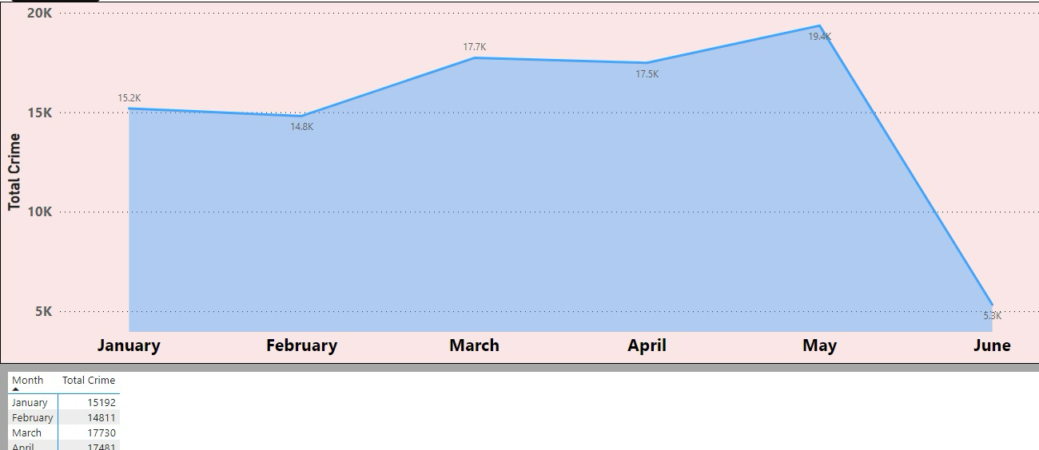
Analysis of Subjective
Monthly fluctuations in crime rates were observed, with a notable decline noted in June.
Efforts to mitigate crime encompassed a multifaceted approach, including enhanced policing, community engagement initiatives, and addressing underlying societal issues.
Tailored interventions are imperative for addressing crime in high-risk areas such as Apartment Street.
Specific security enhancements are warranted for Wards 42, 27, 28, 6, and 24 to address their elevated crime rates.
The variability of crime rates across different months and days underscores the necessity for proactive measures in law enforcement strategies.
Concerns arise due to the notably low arrest rates for domestic crimes, indicating potential weaknesses in law enforcement procedures.

Slide 9
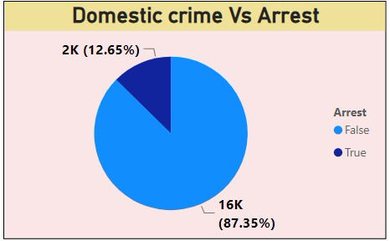
Analysis of Subjective
Concerns arise due to the notably low arrest rates for domestic crimes, indicating potential weaknesses in law enforcement procedures.
Analysis of common terms within crime descriptions provides insights into prevalent crime types within the dataset.
Resolution times for cases display variability based on factors such as the nature of the crime and its location.
The most prevalent crime types identified include theft, battery, and criminal damage.
Secure data access and real-time analytics are facilitated through the utilization of the Power BI Gateway.
A many-to-one relationship is evident between districts in crime data and district_ids in a newly established table, indicating the need for careful consideration in data analysis and management processes.

Slide 10





Essential Insights
Total crime - 89898 Total Crime Type- 31 Arrest Rate - 12.42%
Domestic Crime Proportion - 20.02% Average Days to Resolve - 9.03

Slide 11

Challenge resolution
Over the past year, Chicago's government has undertaken a concerted effort to combat the city's persistent crime challenges through the deployment of high-performing police officers in a decisive operation. As we assess the outcomes of this endeavor, our analysis delves into various dimensions of crime data to assess its efficacy and pinpoint areas necessitating improvement.

Slide 12
Conclusion :
Monthly Fluctuations : Crime rates exhibited monthly fluctuations, peaking in May and declining in June. This underscores the importance of analyzing temporal patterns to guide targeted interventions and resource allocation effectively.
Crime Diversity and Arrest Rates : Theft and battery emerged as prevalent crime types, each with distinct arrest rates. This highlights the necessity for law enforcement strategies tailored to the nuances of different crimes and their perpetrators.
Geographical Concentrations : Certain locales such as Apartment Street and Residence Location demonstrated heightened crime rates, indicating the need for concentrated policing efforts and community involvement to address local issues comprehensively.
Resolution Time and Severity : The time taken to resolve crimes varied, suggesting differences in complexity and resource requirements. Efficient case management and resource allocation strategies are crucial to expedite resolution times and enhance overall crime management efforts.

Slide 13
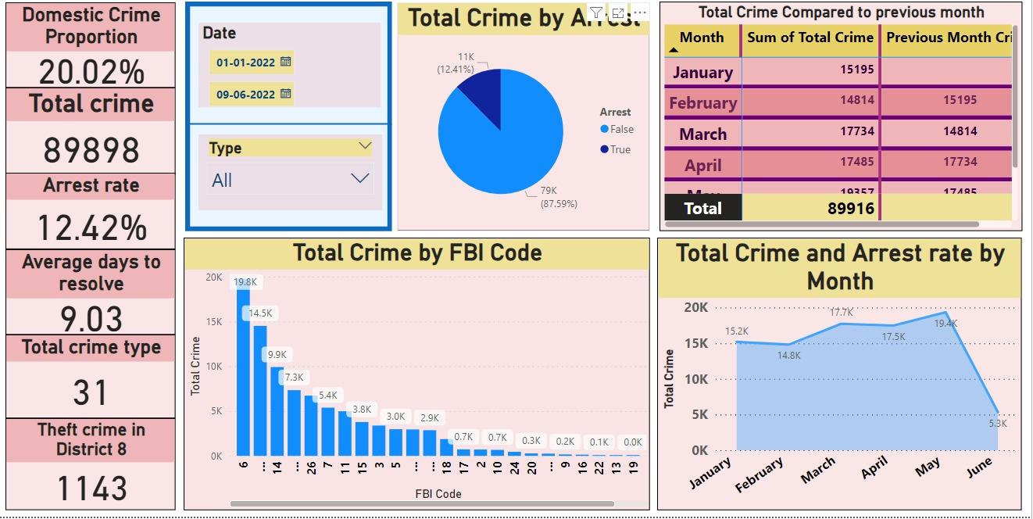
Main Tab

Slide 14
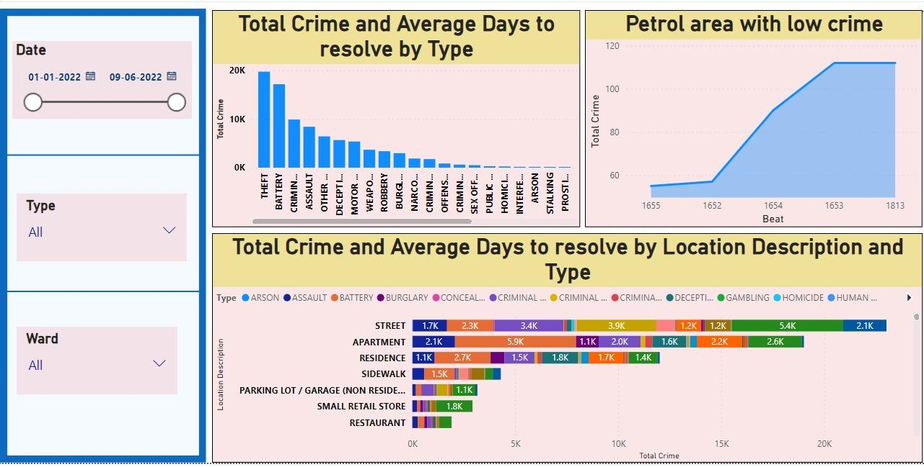
Locality tab

Slide 15
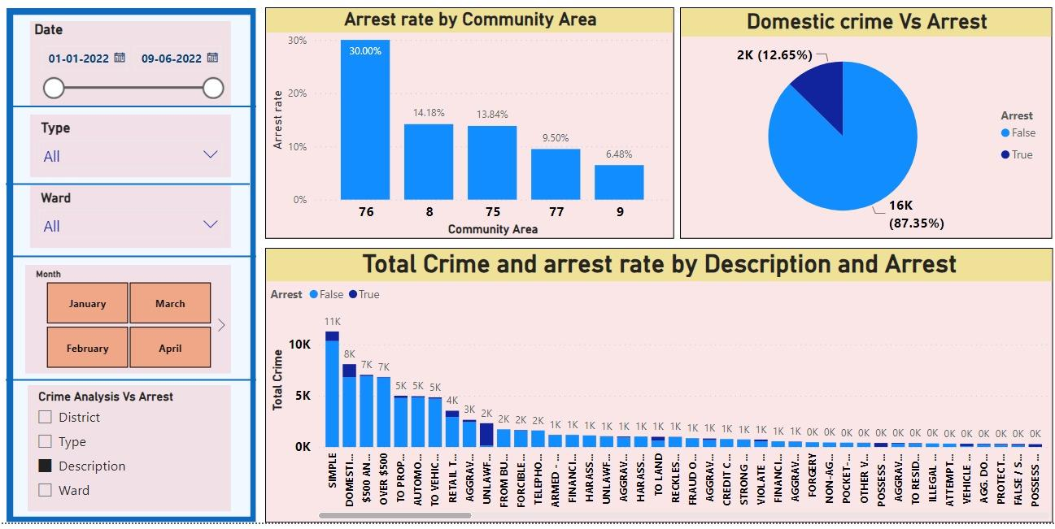
Exploration tab

Slide 16


